Slide 1
Data Structures

Slide 2
Overview & Why ?
Way of organizing data
Reduce the space and time complexities of different tasks.
High speed in processing
Efficiency of a program
Reusability and Abstraction

Slide 3
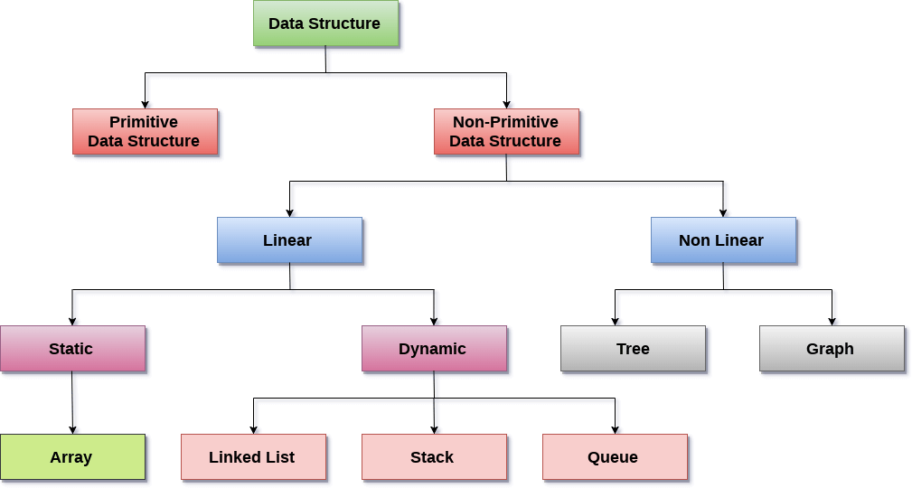
Data Structure Classification

Slide 4
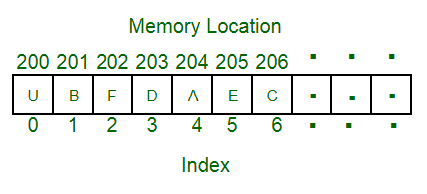
Array
Linear data structure
Elements are stored at contiguous memory locations.
Store multiple items of the same type together
Advantages :
Random access is allowed
Ease of insertion and in Accesss
Drawbacks:
Static memory allocation
Deletion requires Shifting of elements

Slide 5
Linked list
Linear data structure
Elements are not stored at contiguous memory locations.
Elements are linked using pointers
Advantages :
Dynamic size (dynamic memory allocation)
Ease of insertion/deletion over unsorted approach
Drawbacks:
Random access is not allowed
Extra memory space for a pointer

Slide 6
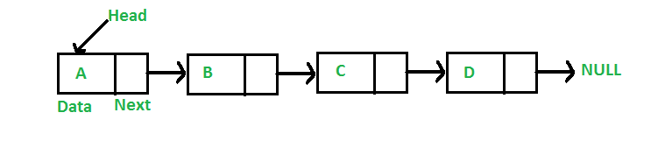
Singly Linked List
class Node
{
public int data;
public Node *next;
};
Node
Each element in the List
consists of at least two parts:
Data
Pointer (Or Reference) to the next node
Linked List

Slide 7
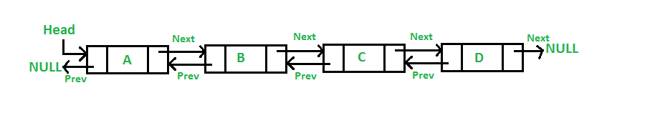
Doubly Linked List
class Node
{
public int data;
public Node *next;
public Node *prev;
};
Node
Each element in the List
consists of at least three parts:
Data
Pointer (Or Reference) to the next node
Pointer Or Reference) to the previous node
Linked List

Slide 8
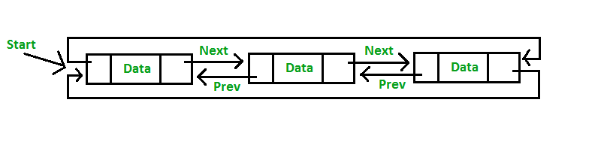
Circular Linked List
class Node
{
public int data;
public Node *next;
public Node *prev;
};
Node
consists of at least three parts:
Data
Pointer (Or Reference) to the next node
Pointer Or Reference) to the previous node
Two consecutive elements are linked or connected by previous and next pointer
Last node points to first node by next pointer
First node points to last node by previous pointer
Linked List

